Slide 1
Hypothesis Testing

Slide 2
Hypothesis
Business case where you are interested in investing in a mutual fund and you want to know whether this investment will yield a certain annual return greater than some desired value let us say 15 percent or 20 percent that you might want.
Medical domain: whether the incidence of diabetes are more for male or female
To know whether women are more likely to change service provider than men
…

Slide 3
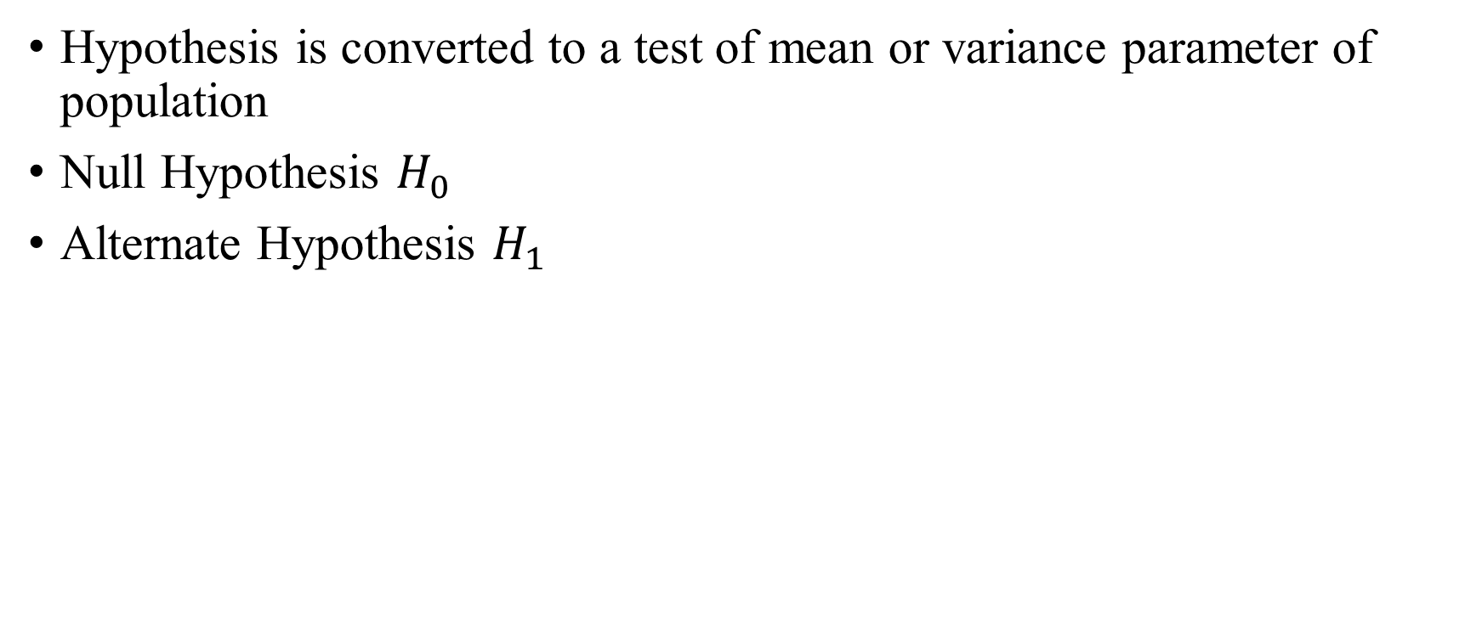
Hypothesis Testing

Slide 4
Hypothesis Testing
Identify the parameter of interest which you wish to test, it could be the mean, it could be the variance of the population or the proportion of the population that you want to verify value.
Now, you construct the null and alternative hypothesis as we said before.
Then, based on a data experimental data about the system you collect and then you construct something called the test statistic. This is a function of the observations.
Derive the distribution of the test statistic under the null hypothesis assumption
Choose the test criterion (threshold) against which the test statistics is compared

Slide 5
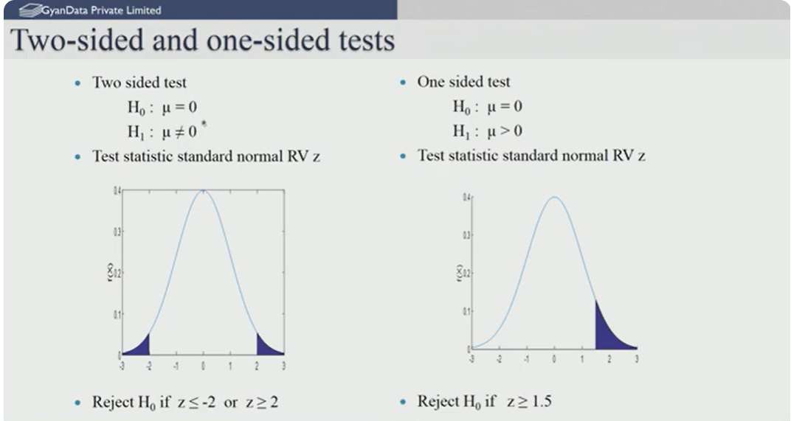
One-tailed or two-tailed
Source: https://youtu.be/BGTzB3R7TxY?si=ctRKKESI673CorEN

Slide 6
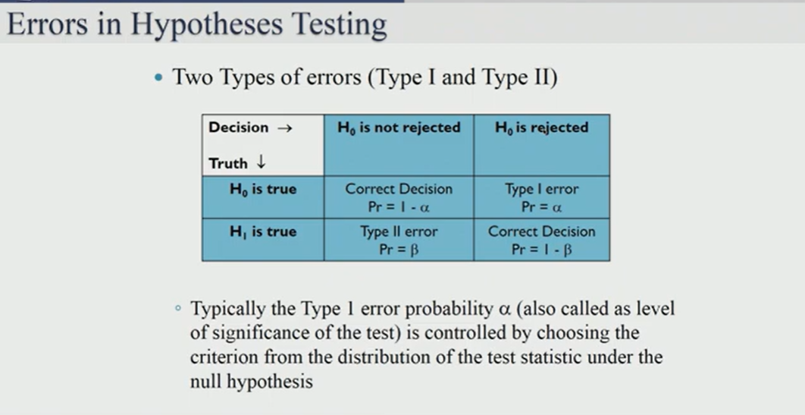
Type-I and II errors
Source: https://youtu.be/BGTzB3R7TxY?si=ctRKKESI673CorEN

Slide 7
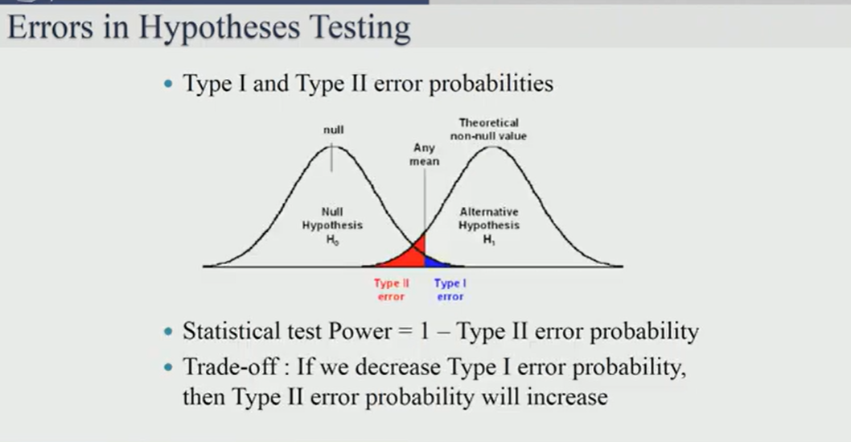
Type-I and II errors

Slide 8
T-test
To determine whether there is a significant difference between the means of two groups. It helps assess whether the observed differences could have occurred by chance.
Types of t-tests:
One-sample t-test: Compares the mean of a single sample to a known or hypothesized population mean.
Independent two-sample t-test: Compares the means of two independent groups (e.g., treatment vs. control groups).
Paired sample t-test (dependent t-test): Compares the means of the same group at two different times (e.g., before and after treatment).

Slide 9
T-test
Assumptions of a t-test:
The data is approximately normally distributed.
The variances of the two groups are equal (for the two-sample t-test).
The samples are independent (in the independent t-test).
The data is continuous and follows an interval or ratio scale.

Slide 10
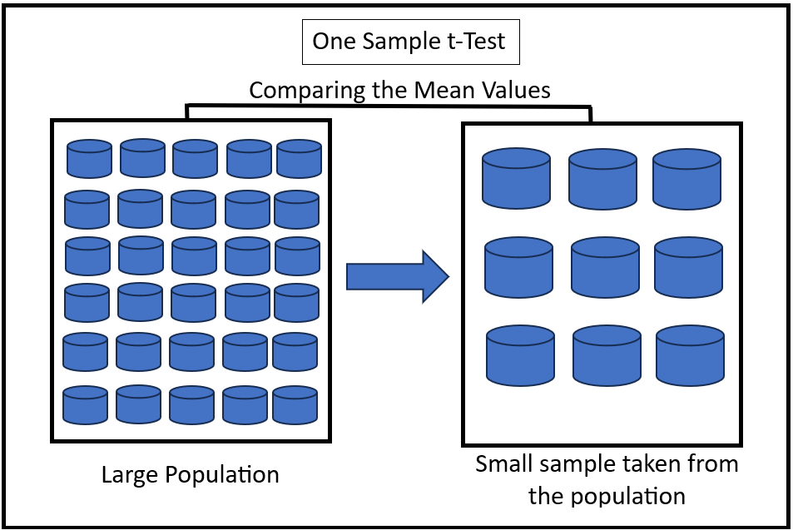

One-sample T-Test
Source: https://en.wikipedia.org/wiki/Student%27s_t-test

Slide 11
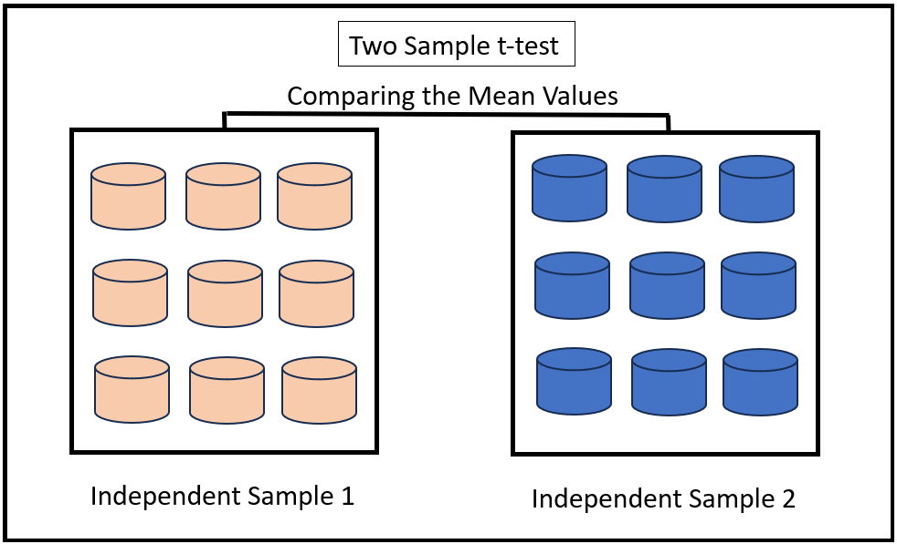
Two-sample t-test
Source: https://en.wikipedia.org/wiki/Student%27s_t-test

Slide 12
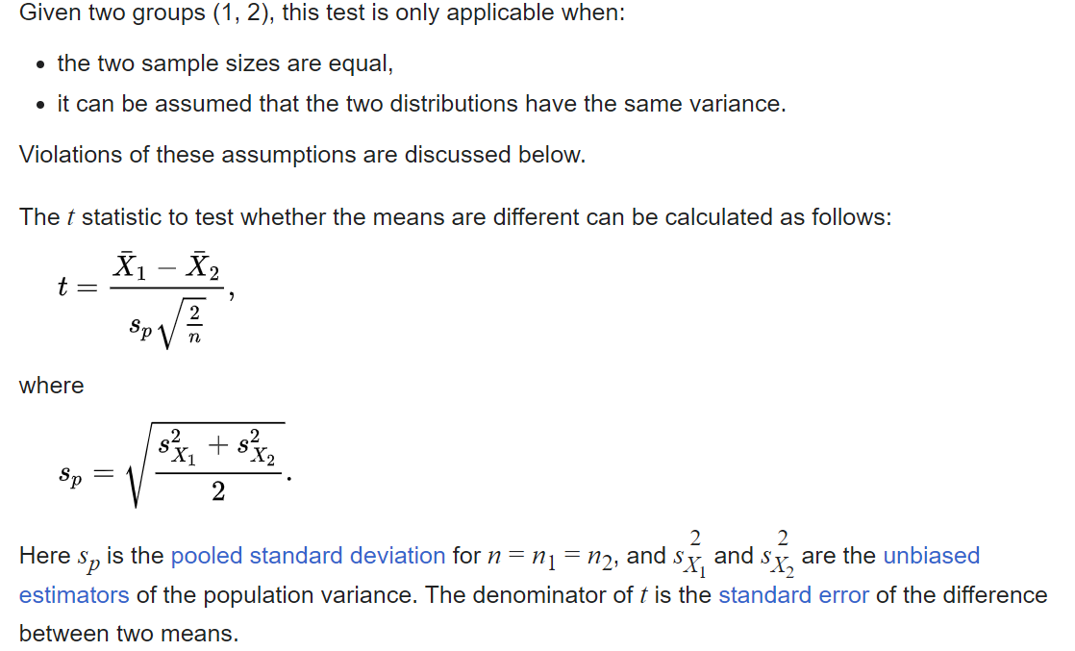
Two-sample t-test
Source: https://en.wikipedia.org/wiki/Student%27s_t-test

Slide 13
Example

